Slide 1
Redis Key-Value Store

Slide 2
Project Architecture
The project is based on two python files.
Redisfunctions, implements all necessary functions for the requested functionality of the system.
Rediswrapper, includes the text & communication for the cli, as well as the initial import of data, and the call of certain scenarios for each requested function.
*Code dependencies: faker package will need to be installed before executing the rediswrapper (or anual input of data and disabling the according code)
Following are parts of the code, indicative of the approach for the implementation

Slide 3
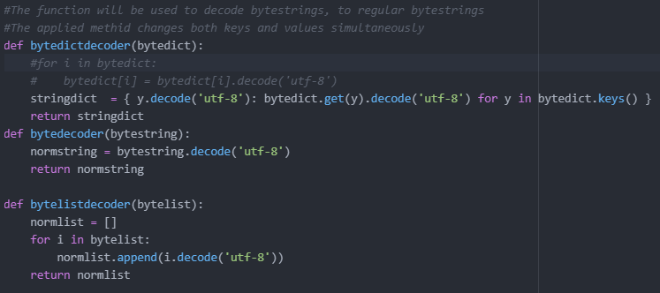
Redisfunctions - Decoders
These functions are implemented, so as to turn the byte data for various redis structures, to regular strings. They are applicable to dicts (for hashes) lists & strings

Slide 4
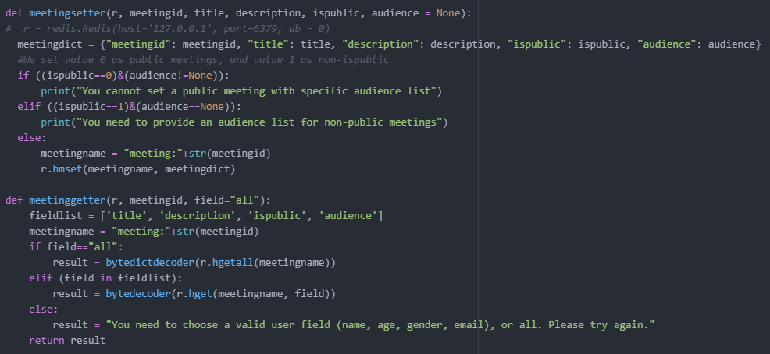
Redisfunctions - Setters & Getters
Setters & Getters are created for all required data structures (apart from eventlog, which only has a getter - since no manual set is considered necessary in the use case).
Some parts assume correct behaviour in logic, while other parts are tested (eg. no audience in a public meeting, no private meeting without audience)
Getters require a specific field to retrieve, or no field at all to get the whole object. Correct behaviour is tested

Slide 5
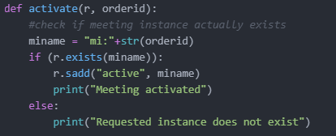
Redisfunctions - Activate
As indicated, “Activate” activates a meeting instance, checking tht it actually exists before making the request to set it as active

Slide 6
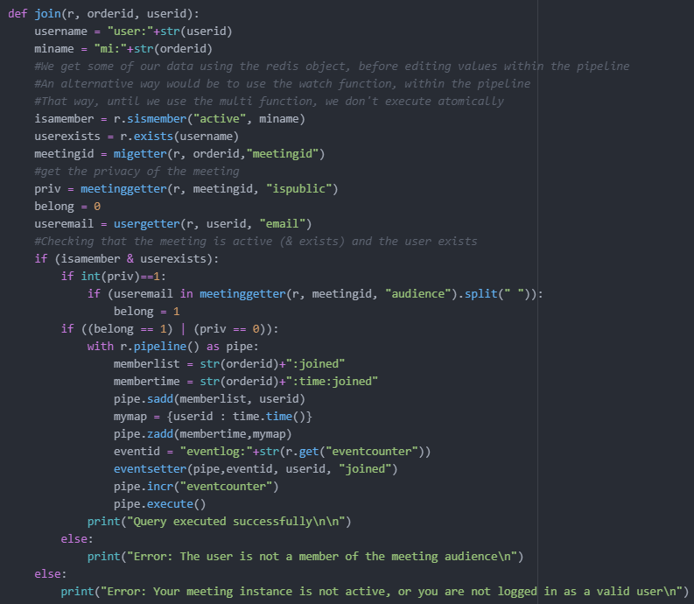
Redisfunctions - Join
Join checks if the user asking to join an instance is a part of the meeting’s audience (or the meeting is public), and if the instance is active. Displays the according message.

Slide 7
Redisfunctions - Join
Join checks if the user asking to join an instance is a part of the meeting’s audience (or the meeting is public), and if the instance is active. Displays the according message.
A pipeline is used (only in the inserting part of the transaction) to ensure no half-processed occurrences, which would lead to inconsistency.
Information retrieval is not within the pipeline, since they are executed after the parsing of all commands, so conditional behaviour before the execution (based on retrieved values) is not possible

Slide 8
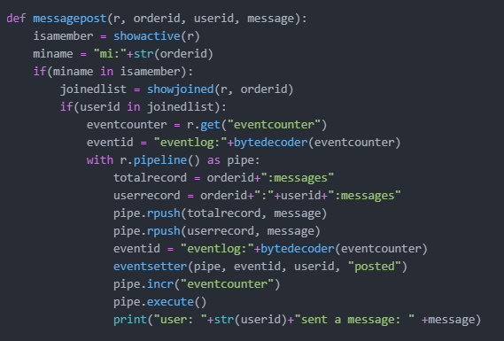
Redisfunctions - Messagepost
Messagepost gets a message recorded
It is implemented with basic redis structured. It uses list, so as to keep by default a chronological order (no need for manipulation of messages in specific positions), and also creates a different structure for each user, in order to print their messages (processing time is prefered over storage space here, so double structures instead of more sophisticated processing techniques within our code to retrieve & manipulate the messages)

Slide 9
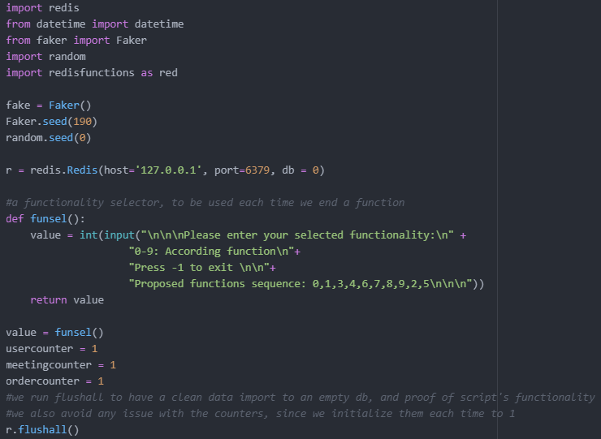
Rediswrapper -Wrapper prep
The synthetic data are created randomly with the help of Faker package, but include an initial state seed, so as to be reproducible.
Funsel is the repeatability loop. Until the exit code is given, functions can be sequentially invoked.
Before any action,a flushall method is called, to ensure an empty db when starting, and have predictable & reproducible results every time. Due to that fact,however , our data only have a timespan of a cli session.
Attention: For educational purposes, counters have two approaches. The depicted counters are created & updated locally, and passed to the redis queries as parameters. On the other hand, eventcounter is stored in redis, and increased through the according redis command.

Slide 10
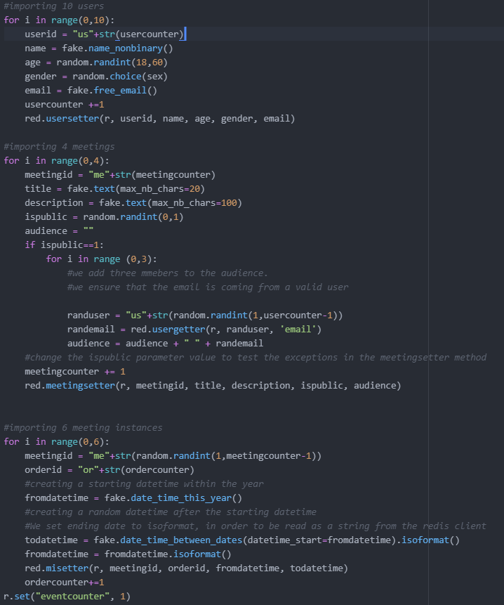
Rediswrapper - Data creation
Users, Meeting (templates) & meeting instances are created right when the wrapper is invoked, following the flushall method.
The rest of the wrapper code is pretty straightforward, in the meaning it only gets some of the created data, calls functions from redisfunctions, and expects a valid result or an error to be shown.
The expected result is descriped within the code. A proposed path for the functions execution is provided in the cli prompts.

Slide 11
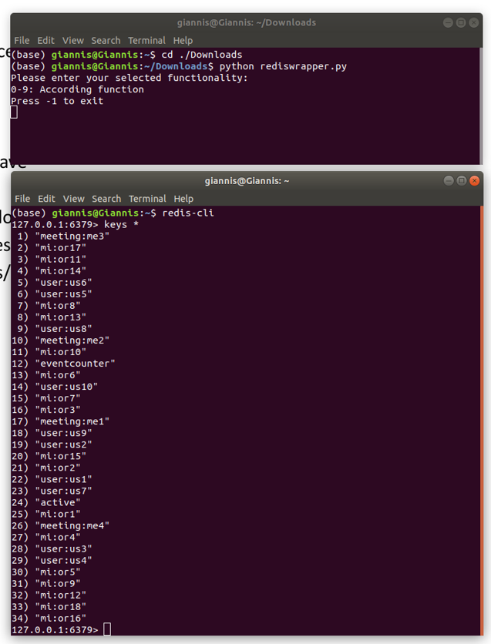
Rediswrapper - Testing & Alternatives discussion
Improvement points & Alternatives:
Counters logic: Obviously, one of the to approaches is optimal, and it should be followed
Sorted set decoder. In contrast with all other structures, the scored set was not set to be decoded, and is as such returned to its original bytestring form.
PubSub: In the context of a messaging app, PubSub’s ability for users to subscribe to a channel and publish is great. However, we couldn’t create a “channel” context (have each meeting as a channel) & there was no persistence functionality. PubSub data are natively session-based, so no storage or recall on demand was possible (or intended by the system itself)
Since version 5.0 of Redis, Streams functionality is possible, which is a way of “channel’ communication, made for fast paced data - mainly from sensors, which are broadcasted, but stored as well. Since the communication is many-many, it could potentially be modified to fit the implementation of a messaging context. Installation of older version by default, as well as the complexity of invoking more types of structures and syntax, made it avoidable for now
Example of initisted script, and created data in redis. The results can be cross-checked with the parallel-client method

Slide 12
Get in touch with the code
The code is also available through this link

